Slide 1
Graphical Models

Slide 2
Overview
3D Geometric Primitives
Point
Line
Plane
Polygon
Sphere
3D Object Representations
Raw Data
Surfaces
Solids
OpenGL Primitives

Slide 3
3D Geometric Primitives
Point
Line
Plane
Polygon
Sphere
Etc.

Slide 4
3D Point
Specifies a Location
Represented by three coordinates
Infinitely small
class Point{
float x, y, z;
};
(x, y, z)

Slide 5
3D Vector
Specifies a Direction and a Magnitude
Represented by three coordinates
Magnitude ||v||=sqrt(d_{x}d_{x} + d_{y}d_{y} +d_{z}d_{z})
Has no location
Dot product of two 3D vector
V₁ V₂ = d_{x1}d_{x2} + d_{y1}d_{y2} + d_{z1}d_{z2}
V₁ V₂ = ||V₁||||V₂|| cos( )
class Vector {
float x, y, z;
};
(d_{x1}, d_{y1}, d_{z1})
(d_{x2}, d_{y2}, d_{z2})

Slide 6
3D Line
Line segment with both endpoints at infinity
Parametric Representation
P=P₁+tV, ( )
class Line {
Point P₁;
Vector V;
float t;
};
V
P₁

Slide 7
3D Ray
Line segment with one endpoint at infinity
Parametric Representation
P=P₁+tV, ( )
class Ray{
Point P₁;
Vector V;
float t;
};
V
P₁

Slide 8
3D Line Segment
Specifies a linear combination of two points
Parametric Representation
P=P₁ + t(P₂ - P₁), ( )
P₂
class Segment{
Point P₁;
Point P₂;
float t;
};
P₁

Slide 9
3D Plane
Specifies a linear combination of three points
Implicit Representation
P N + d = 0, or
ax + by + cz + d = 0
N=(a, b, c)
P₁
P₃
class Plane{
Vector N;
float d;
};
P₂
d
Origin

Slide 10
3D Polygon
Area “inside” a sequence of coplanar points
Triangle
Quadrilateral
Convex
Star-shaped
Concave
Self-Intersecting
Hole
typedef struct{
Point *Points;
int npoints;
} Polygon;
Points are in counter-clockwise order

Slide 11
3D Sphere
All points at distance “r” from a center (c_{x}, c_{y}, c_{z})
Implicit Representation
(x-c_{x})² + (y-c_{y})² + (z-c_{z}) ² = r ²
Parametric Representation
x= r sin( ) cos( )
y= r sin( ) sin( )
z= r cos( )
(c_{x}, c_{y}, c_{z})
r

Slide 12
3D Object Representations
Raw Data
Point Cloud
Range Image
Polygon Soup
Surfaces
Mesh, Subdivision, Parametric, Implicit
Solids
Voxel, BSP tree, CSG, Sweep

Slide 13
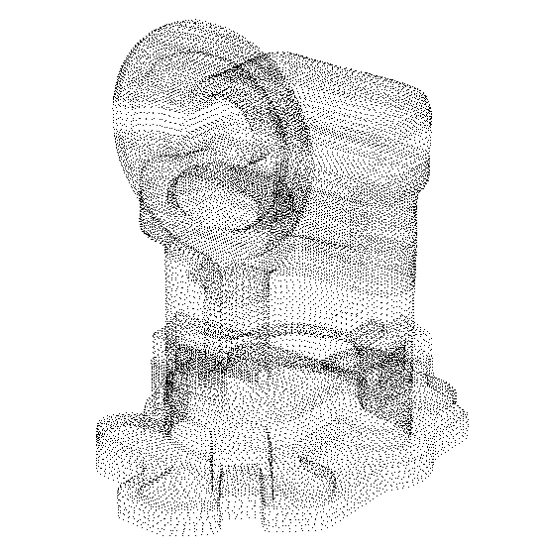
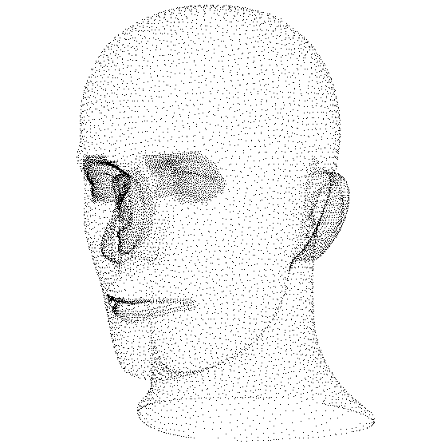
Point Cloud
Unstructured Set of 3D Point Samples
Acquired from 3D scanners, computer vision, etc

Slide 14
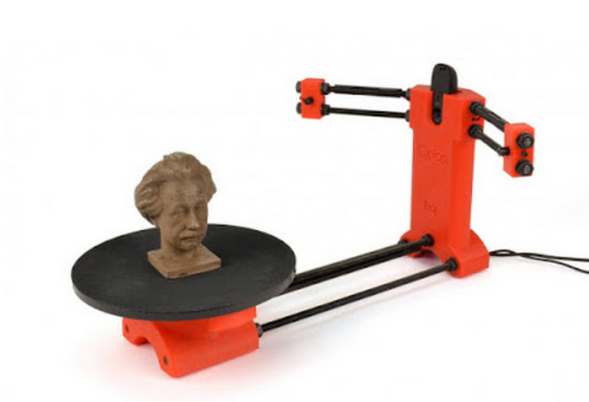
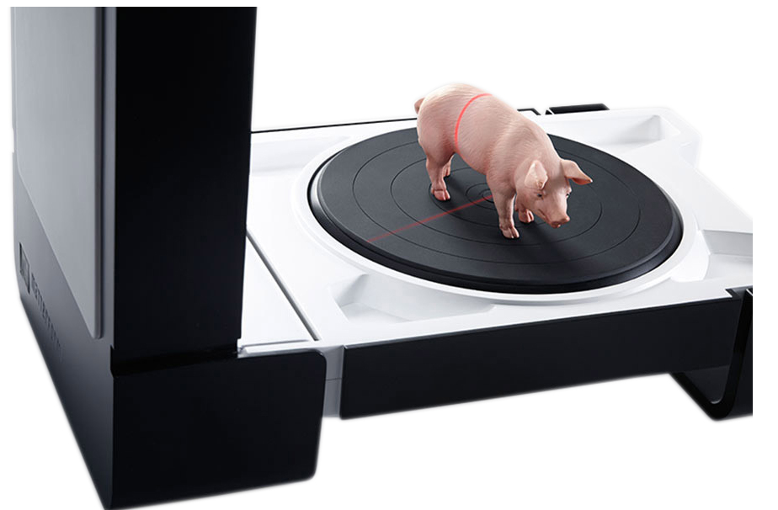
Point Cloud
Devices
Laser Scanner

Slide 15
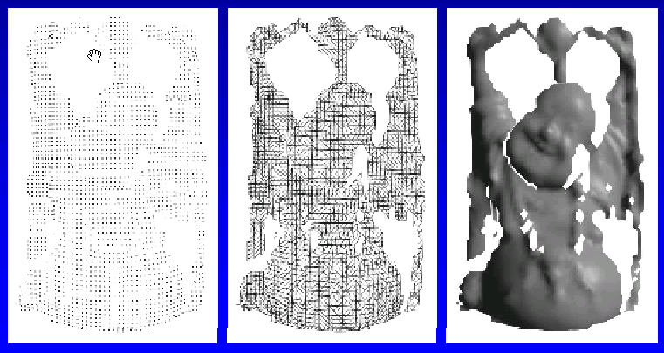
Range Image
Set of 3D Points Mapping to Pixels of Depth Image
Acquired from range scanner
Range Image
Tessellation
Range Surface

Slide 16
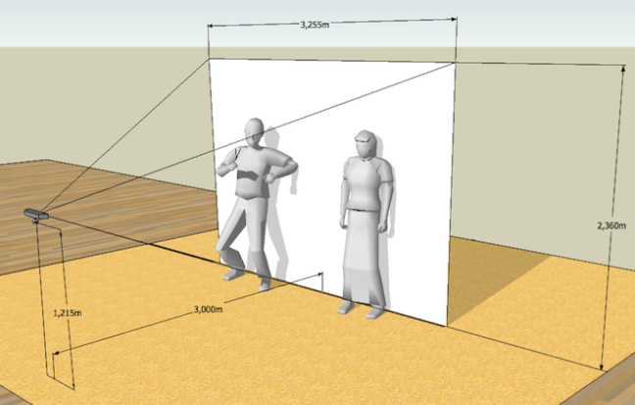
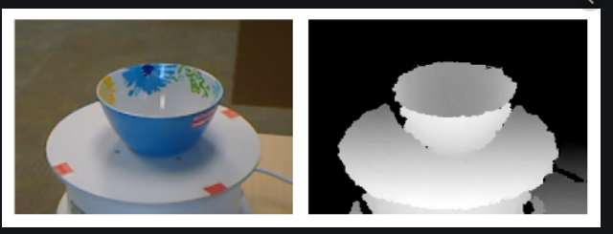
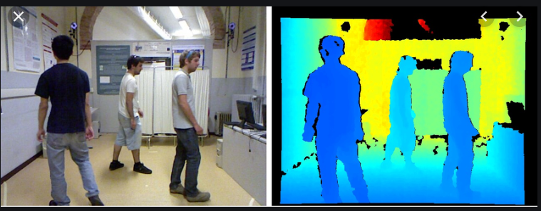
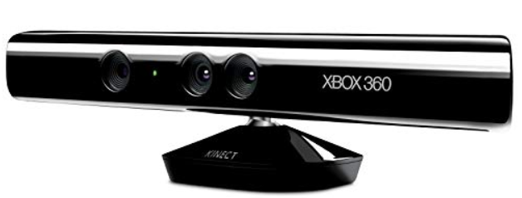
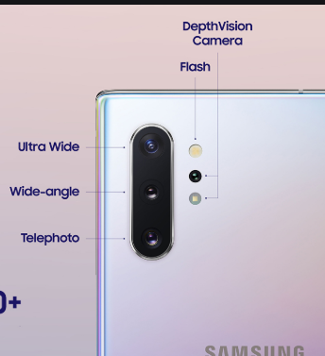
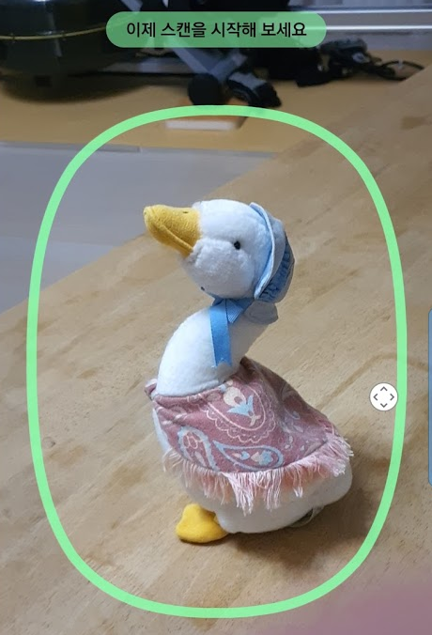
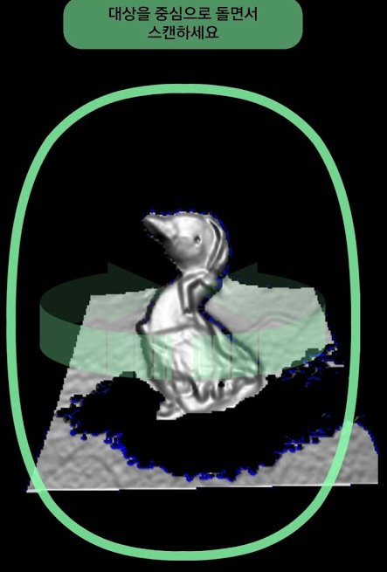
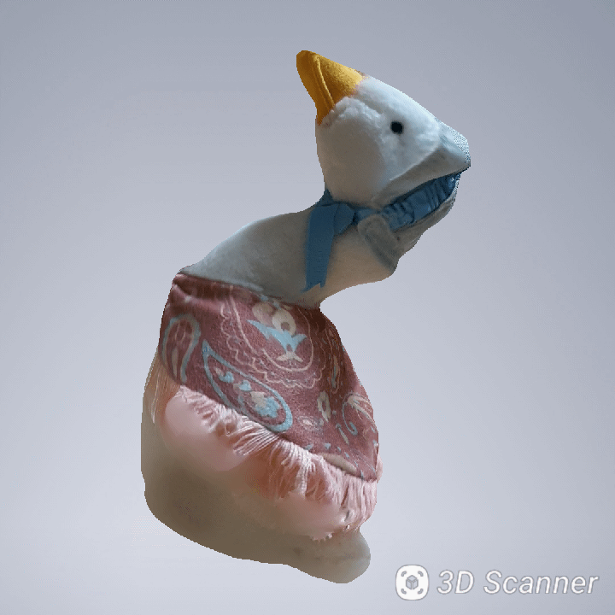
Range Image
Devices
Kinect
Galaxy Note 10+

Slide 17
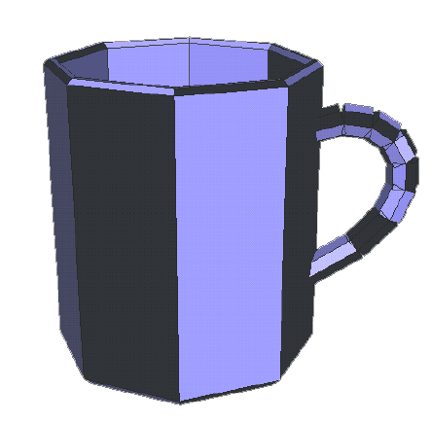
Polygon Soup
Unstructured Set of Polygons
Created with interactive modeling systems

Slide 18
3D Object Representations
Raw Data
Point cloud, Range image, Polygon soup
Surfaces
Mesh
Subdivision
Parametric
Implicit
Solids
Voxel, BSP tree, CSG, Sweep

Slide 19
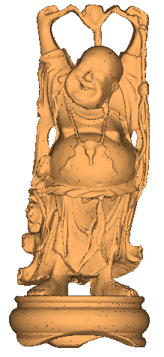
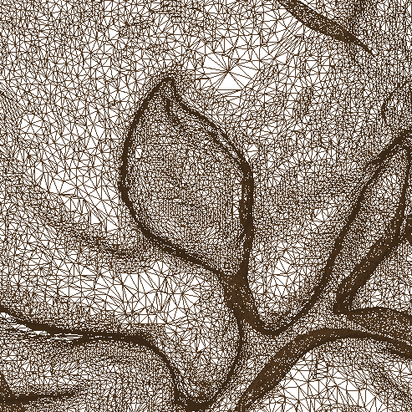
Mesh
Connected Set of Polygons (Usually Triangles)
May not be closed

Slide 20
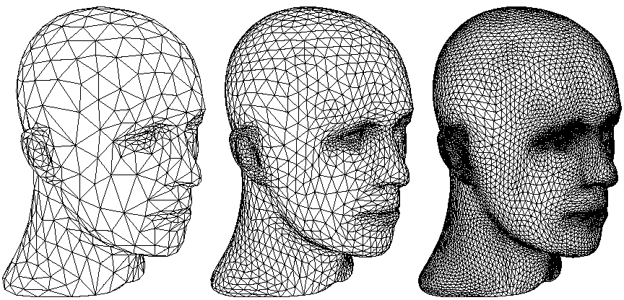
Subdivision Surfaces
Coarse Mesh & Subdivision Rule
Define smooth surface as limit of sequence of refinements

Slide 21
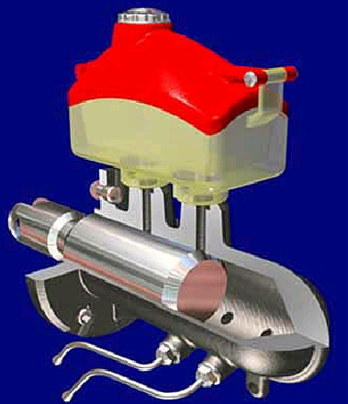
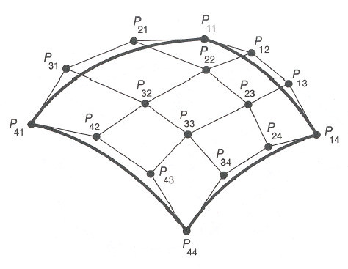
Parametric Surfaces
Tensor Product Spline Patches
Careful constraints to maintain continuity

Slide 22
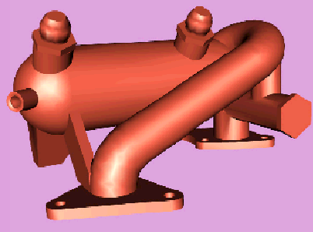

Implicit Surface
Points satisfying: F(x,y,z) = 0
Polygonal Model
Implicit Model

Slide 23
3D Object Representations
Raw Data
Point cloud, Range image, Polygon soup
Surfaces
Mesh, Subdivision, Parametric, Implicit
Solids
Voxel
BSP tree
CSG
Sweep

Slide 24
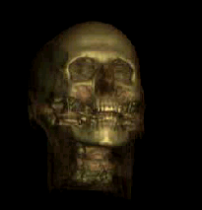
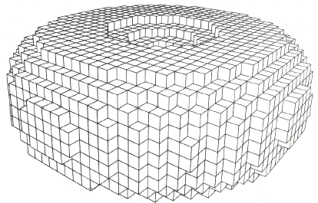
Voxels
Uniform Grid of Volumetric Samples
Acquired from CAT, MRI, etc.

Slide 25
BSP Tree
Binary Space Partition with Solid Cells Labeled
Constructed from polygonal representations
1
a
b
1
a
g
a
g
6
c
2
f
f
3
d
3
e
5
e
7
4
e
d
c
4
d
c
b
b
f
5
2
6
7
Object
Binary Spatial Partition
BSP Tree

